Slide 1

MUTHAYAMMAL ENGINEERING COLLEGE
(Autonomous)
Rasipuram - 637 408, Namakkal (Dt.), Tamil Nadu, India.
Department of Information Technology
SMART AGRICULTURAL FARM TO SHOP SUPPLY MANAGEMENT ADVANCED DIGITAL BOOKING PLATFORM
Project Guide
Dr.D.Anitha, M.E ,Ph.D
Head of The Department,
Department of Information Technology
Presented by
Praveen R [22IT058]
Pradeep N [22IT056]
Rajeshkanna S [22IT062]
Yathunanthan P [23IT508]

Slide 2
AGENDA
ABSTRACT
INTRODUCTION
LITERATURE SURVEY
SYSTEM ARCHITECTURE
EXISTING SYSTEM
PROPOSED SYSTEM
LIST OF MODULES
OUTPUT SCREENSHOTS
FUTURE ENHANCEMENT
CONCLUSION
REFERENCE

Slide 3
ABSTRACT
Agricultural trading environment, farmers struggle to sell products directly to shops due to middlemen involvement, unpredictable pricing, and lack of digital transparency.
Product Recommendation Algorithm to assist shops in selecting suitable farm products, and a Supply Chain Tracking Algorithm to provide transparent farm-to-shop movement monitoring.
Ensures fair pricing, reduces dependency on middlemen, improves booking accuracy, and enhances operational direct connection between farmers and shop owners

Slide 4
INTRODUCTION
Agriculture plays an important role in our country, but farmers often face problems in selling their products directly to customers. Middle man reduce profits and increase prices.
System ensures fair pricing, fresh products for customers, and better income for farmers. It also improves transparency and trust in the supply process and avoid the middle man.
digital platform that connects farmers, shopkeepers, and customers in one system. It helps in easy product listing, ordering, and payment.

Slide 5
LITERATURE SURVEY
Title: Organic Farming and Direct to Consumer Marketing. Author & Year: Dr.Sincya , Sreyas George(2025)
Description: A web-based portal that connects farmers and Consumer for direct produce booking and transparent marketing. Limitations: Does not include real-time booking or farmer confirmation options. Limited scalability and lacks multilingual local language support for rural users.

Slide 6
SYSTEM ARCHITECTURE
SMART FARM TO SHOP MANAGEMENT AND BOOKING SYSTEM
Admin
Farmer
Shopkeeper
Login
Register
Register
View Details
Login
Login
Delete account
Add product
View product details
View Sales Report
Demand request
Demand request
View Complaint
Accept/ reject
View status
Post Solution
Status
Booking / payment
Complaint & solution
Order tracking
Complaint & solution
Data Base

Slide 7
EXISTING SYSTEM
In the existing agricultural system, farmers face many difficulties in selling their products directly to the market. Most farmers depend on middlemen or wholesalers, which reduces their profit margins.
As a result, farmers struggle with unfair pricing, limited market access, and lack of transparency in product tracking.
Although some online platforms exist, they mainly focus on crop information or selling through third-party apps. These systems do not provide features like booking, order management, or real-time tracking between farms and shops.

Slide 8
PROPOSED SYSTEM
In this system, farmers can list their products with price, quantity, and availability details. A special feature allows farmers to hold or confirm orders based on stock availability and delivery readiness, which helps them manage demand efficiently.
The system also uses location-based services to find the nearest farmers and shops, reducing transportation time and cost. Most importantly, it helps to avoid brokerage or middlemen, ensuring farmers receive the right value for their produce while shop owners get fresh goods at reasonable prices.
Features such as order management, booking notifications, and tracking updates make the process smooth and transparent.

Slide 9
LIST OF MODULES
Farmer Panel:
Register / Login: Farmers can create an account and log in securely to access the system
Add Product : Farmers can add product details such as name, quantity, price, and availability.
View Demand Request : Farmers can view demand requests sent by shopkeepers for their products.
Shop Panel:
Demand Request : Shopkeepers can send demand requests to farmers for required products.
View Product Details :Shopkeepers can view available farm products with price and quantity details.

Slide 10
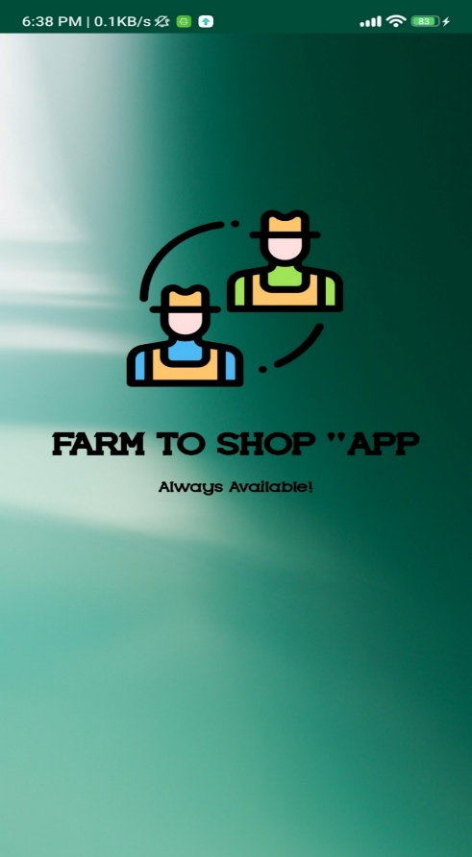
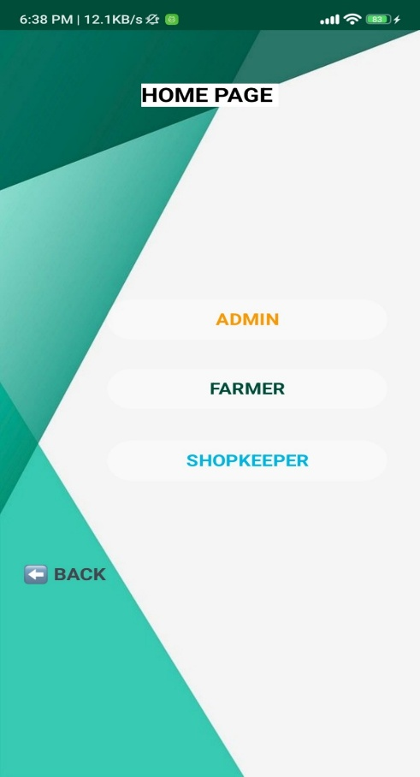
OUTPUT SCREENSHOTS

Slide 11
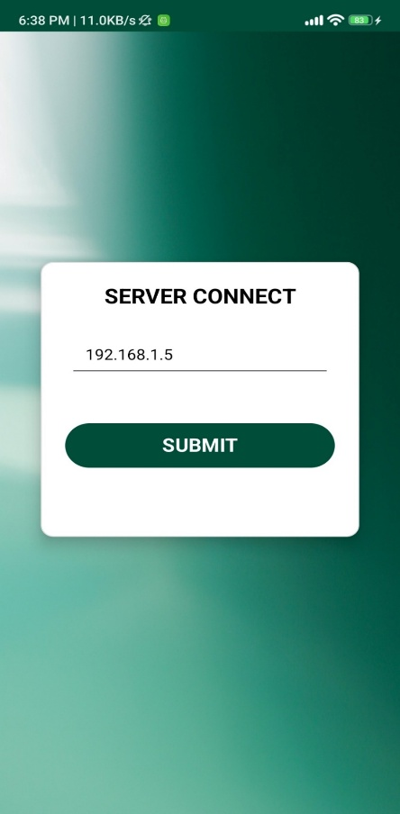
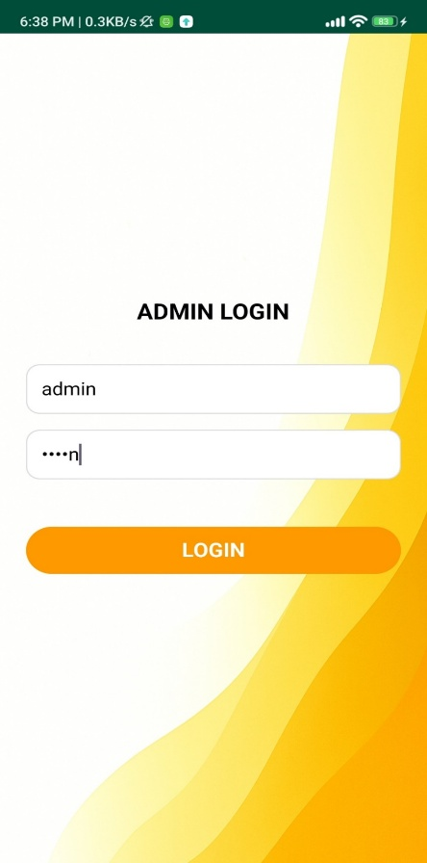
OUTPUT SCREENSHOTS

Slide 12
FUTURE ENHANCEMENT
Regional Language Support: Adding support for regional and local languages to help farmers and shopkeepers use the system easily and comfortably.
Real-Time Tracking: Integrating GPS and IoT technologies for live order and delivery tracking
Advanced Analytics: Using AI and data analytics to predict demand, optimize pricing, and reduce wastage.

Slide 13
CONCLUSION
The Smart Farm to Shop Management and Booking System presents a practical, transparent, and user-friendly platform that connects farmers and shopkeepers digitally.
Using built-in complaint and solutions modules for once the transaction is completed, also allows for increased user trust through a structured complaint response capability.
The entire trading process has been simplified starting from the posting for product availability, negotiation of demand, booking and payment, and tracking

Slide 14
REFERENCE
Holzinger A. et al. — Human-Centered in Smart Farming: Toward Agriculture 5.0, IEEE Access, 2024.
Zhou R. & Yin Y. — Digital Agriculture: Mapping Knowledge Structure and Trends, IEEE Access, 2023.
Louta M. et al. — Emerging Technologies for Sustainable Agriculture, IEEE Access, 2024.

Slide 15
THANK YOU

